Slide 1
CSE-361:Compiler Design

Slide 2
Parsing : Part-I

Slide 3

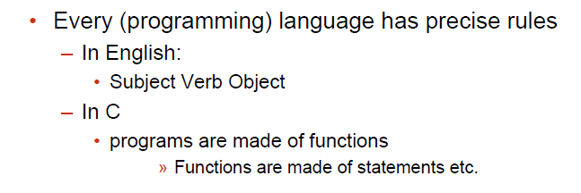

Slide 4
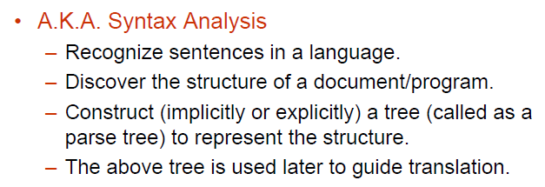
Parsing

Slide 5
Parsing During Compilation
regular expressions
errors
lexical analyzer
token
rest of front end
intermediate representation
source program
parser
parse tree
get next token
symbol table
Collecting token information
Perform type checking
Intermediate code generation
uses a grammar to check structure of tokens
produces a parse tree
syntactic errors and recovery
recognize correct syntax
report errors

Slide 6
Parsers
We categorize the parsers into two groups:
1. Top- Down Parser: The parse tree is created top to bottom, starting from the root
2. Bottom-Up Parser: The parse tree is created bottom to top, starting from the leaves
Both Top-Down and Bottom-Up parsers scan the input from left to right ( One symbol at a time)
Efficient Top-Down and Bottom-Up parsers can be implement only for the sub-classes of context free grammars
LL for top-down parsing
LR for bottom-up parsing

Slide 7
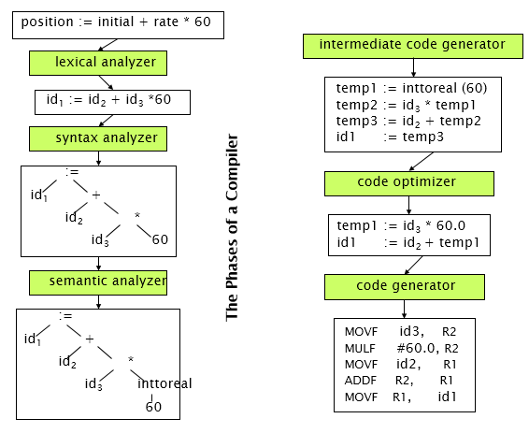

Slide 8
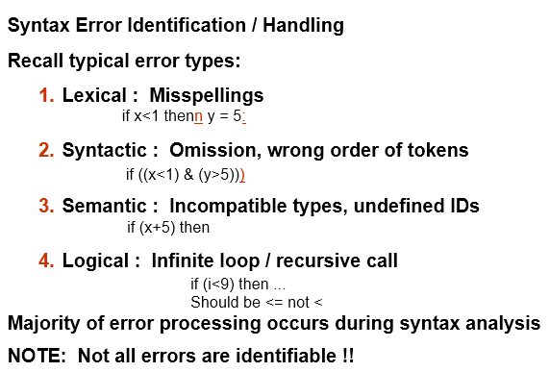
Errors in Programs

Slide 9
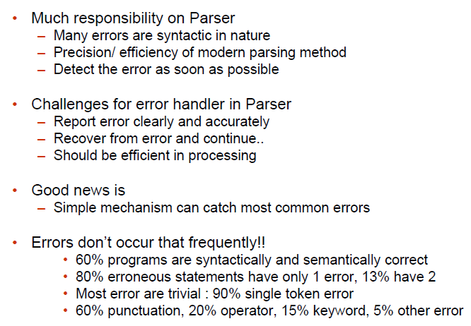
Error Detection

Slide 10
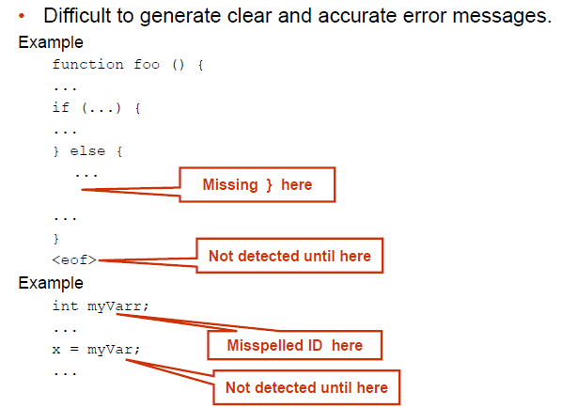
Adequate Error Reporting is Not a Trivial Task

Slide 11
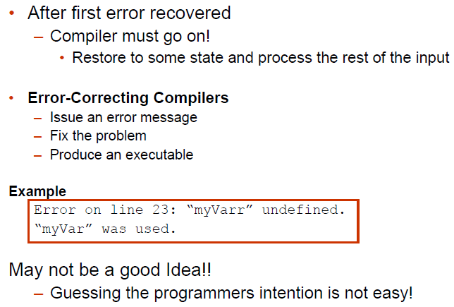
Error Recovery

Slide 12
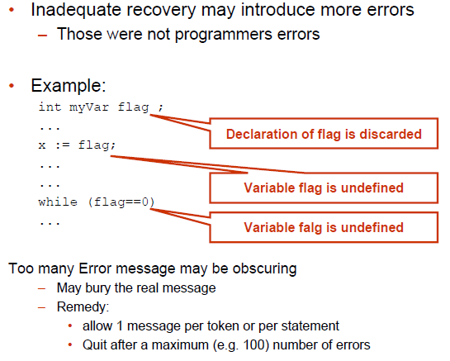
Error Recovery May Trigger More Errors!

Slide 13
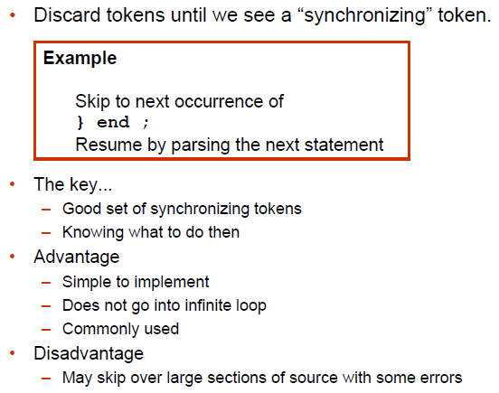
Error Recovery Approaches: Panic Mode

Slide 14
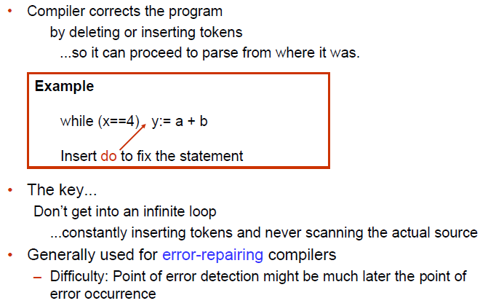
Error Recovery Approaches: Phrase-Level Recovery

Slide 15
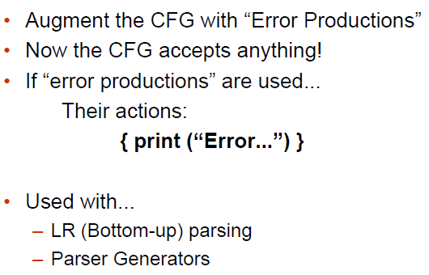
Error Recovery Approaches: Error Productions

Slide 16
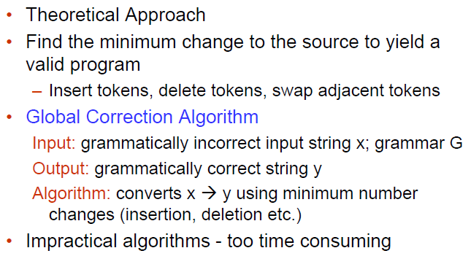
Error Recovery Approaches: Global Correction

Slide 17
Syntactical Analysis
Each language definition has rules that describe the syntax of well formed programs. • Format of the rules: context-free grammars • Why not regular expressions/NFA’s/DFA’s?
Source program constructs have recursive structure:
digits = [0-9]+; expr = digits | “(“ expr “+” expr “)”
Finite automata can’t recognize recursive constructs, so cannot ensure expressions are well-bracketed: a machine with N states cannot remember parenthesis—nesting depth greater than N
CFG’s are more powerful, but also more costly to implement

Slide 18
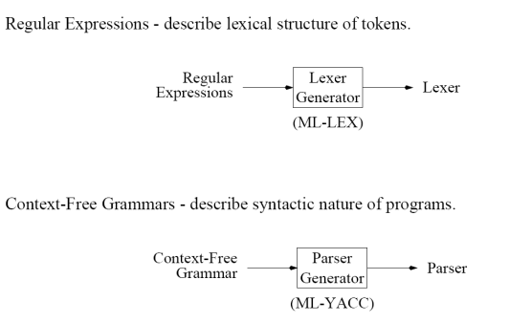
CFG versus Regular Expression

Slide 19
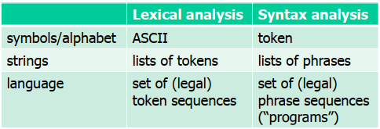
CFG versus Regular Expression
Language: set of strings String: finite sequence of symbols taken from finite alphabet
Regular expressions and CFG’s both describe languages, but over different alphabets

Slide 20
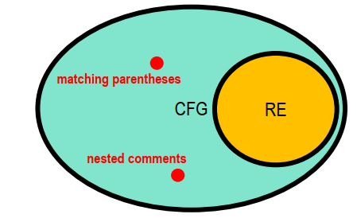
CFG versus Regular Expression
CFG’s strictly more expressive than RE’s:
Any language recognizable/generated by a RE can also be recognized/generated by a CFG, but not vice versa.
Also known as Backus-Naur Form (BNF, Algol 60)

Slide 21
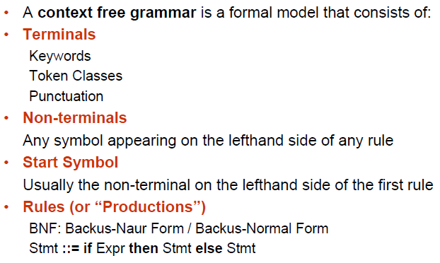
Context Free Grammars (CFG)

Slide 22
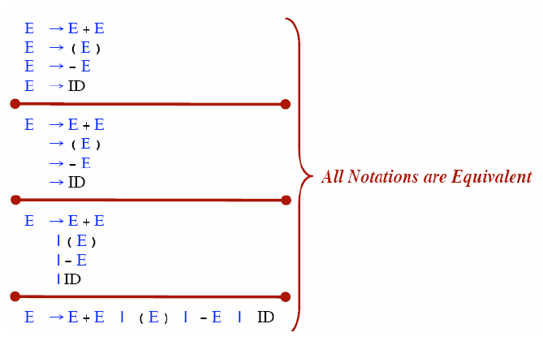
Rule Alternative Notations

Slide 23
Notational Conventions
Terminals
Lower-case letters early in the alphabet: a, b, c
Operator symbols: +, -
Punctuations symbols: parentheses, comma
Boldface strings: id or if
Nonterminals:
Upper-case letters early in the alphabet: A, B, C
The letter S (start symbol)
Lower-case italic names: expr or stmt
Upper-case letters late in the alphabet, such as X, Y, Z, represent either nonterminals or terminals.
Lower-case letters late in the alphabet, such as u, v, …, z, represent strings of terminals.

Slide 24
Notational Conventions
Lower-case Greek letters, such as α, β, γ, represent strings of grammar symbols.
Thus A→ α indicates that there is a single nonterminal A on the left side of the production and a string of grammar symbols α to the right of the arrow.
If A→ α₁, A→ α₂, …., A→ α_{k} are all productions with A on the left, we may write:
A→ α₁ | α₂ | …. | α_{k}
Unless otherwise started, the left side of the first production is the start symbol.
E → E A E | ( E ) | -E | id
A → + | - | * | / | ↑

Slide 25
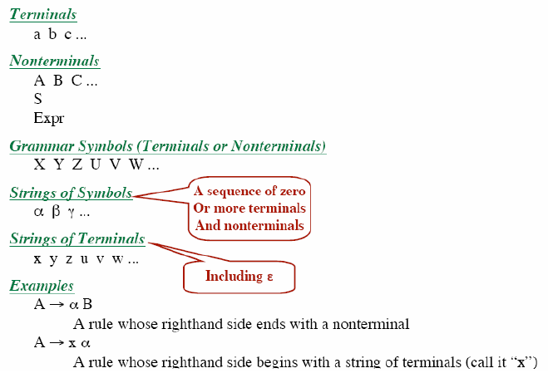
Summary of Notational Conventions

Slide 26
Context Free Grammars : A First Look
Production rules:
1. assign_stmt → id := expr ;
2. expr → expr operator term
3. expr → term
4. term → id
5. term → real
6. term → integer
7. operator → +
8. operator → -
Derivation: A sequence of grammar rule applications and substitutions that transform a starting non-term into a sequence of terminals / tokens.
Terminals: id real integer + - := ;
Nonterminals: assign_stmt, expr, operator, term
Start symbol: assign_stmt

Slide 27
Example Grammar: Simple Arithmetic Expressions
expr → expr op expr
expr → ( expr )
expr → - expr
expr → id
op → +
op → -
op → *
op → /
op → ↑
9 Production rules
Terminals: id + - * / ↑ ( )
Nonterminals: expr, op
Start symbol: expr

Slide 28
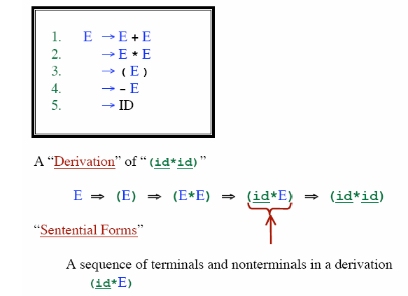
Derivations

Slide 29
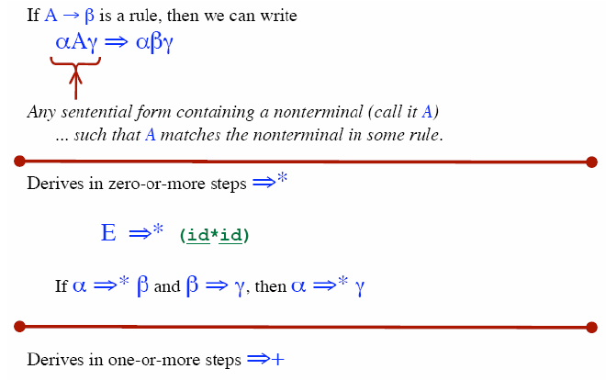
Derivations

Slide 30
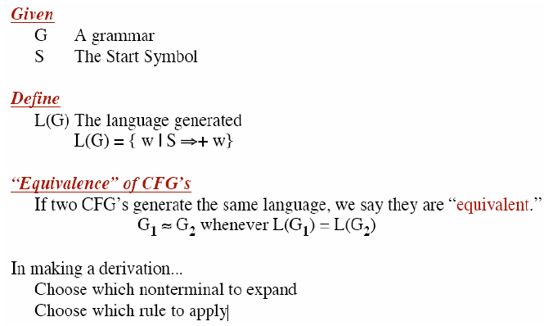
CFG Terminology

Slide 31
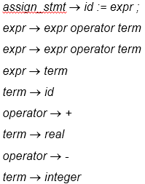
Derivation
Let’s derive: id = id + real – integer ;
production rules:
assign_stmt
id = expr ;
id = expr operator term;
id = expr operator term operator term;
id = term operator term operator term;
id = id operator term operator term;
id = id + term operator term;
id = id + real operator term;
id = id + real - term;
id = id + real - integer;
=

Slide 32
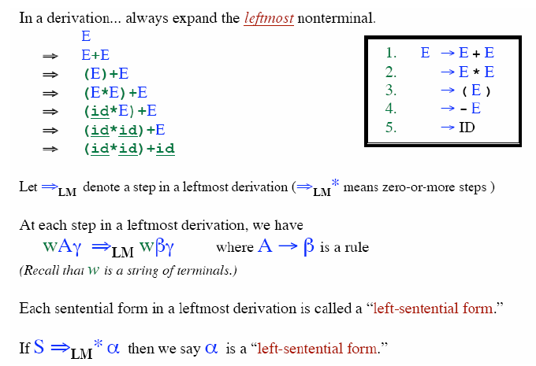
Leftmost Derivation

Slide 33
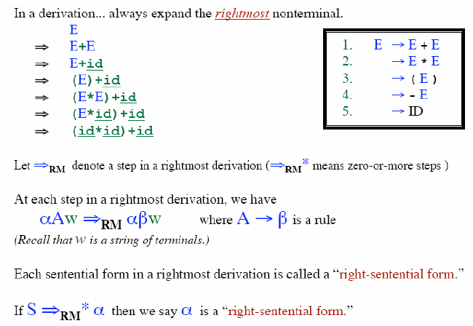
Rightmost Derivation

Slide 34
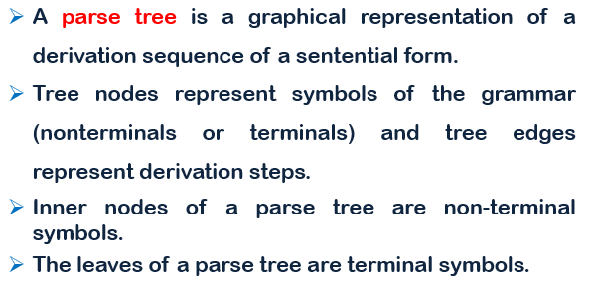
Parse Tree

Slide 35
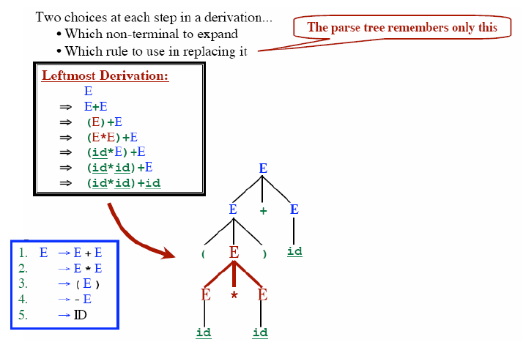
Parse Tree
Input: (id * id) + id

Slide 36
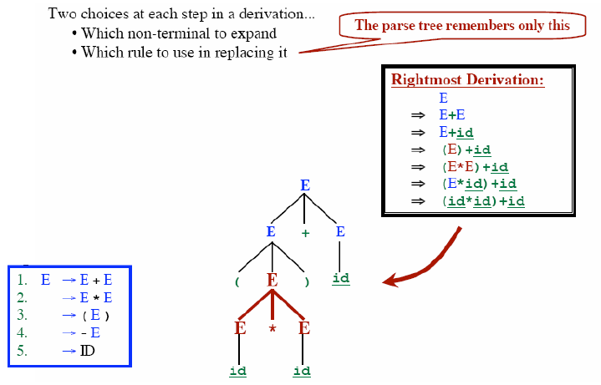
Parse Tree
Input: (id * id) + id

Slide 37
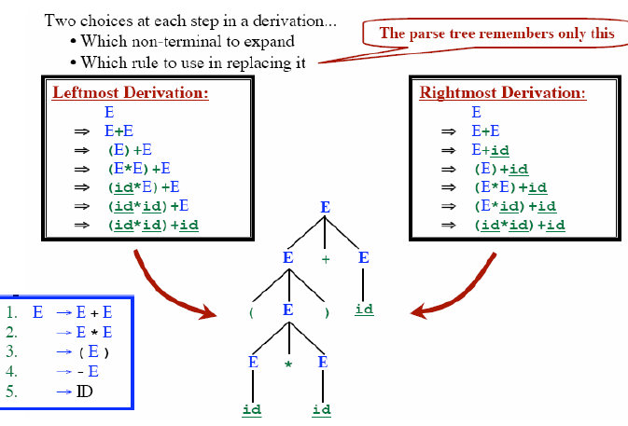
Parse Tree
Notes:
, the phrase “x = +y", which is recognized as four tokens, representing “x", “=“ and “+" and “y", has the structure =(x,+(y)), i.e., an assignment expression, that operates on “x" and the expression “+(y)".

Slide 38
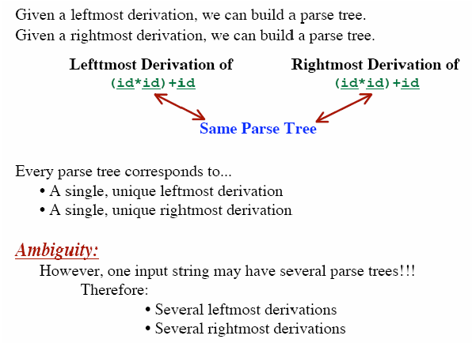
Parse Tree

Slide 39

Ambiguous Grammar

Slide 40
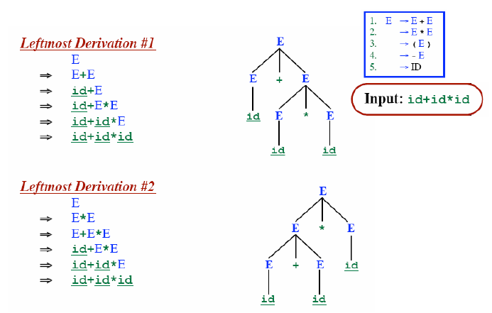
Ambiguous Grammar
Two different parse trees!!
Which derivation of the parse tree is correct??

Slide 41
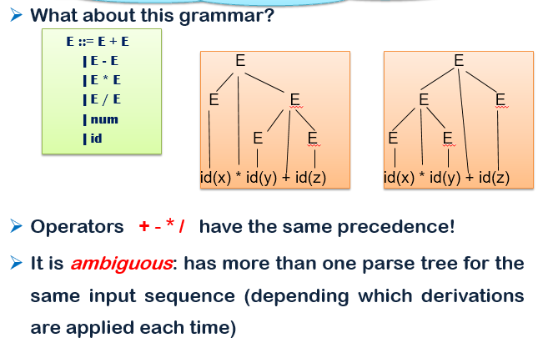
Ambiguous Grammar

Slide 42
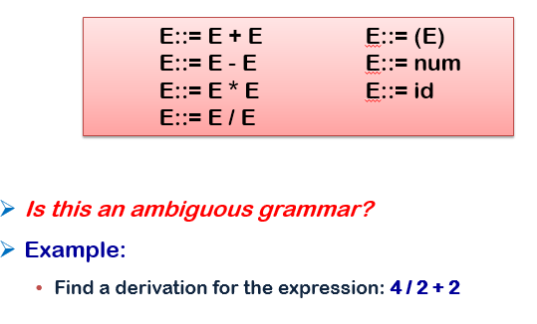
Ambiguous Grammar
YES

Slide 43
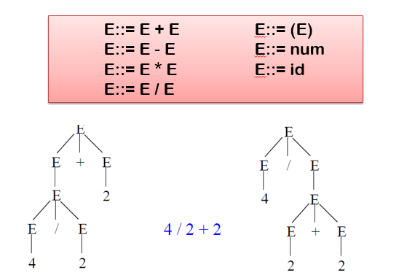
Ambiguous Grammar

Slide 44
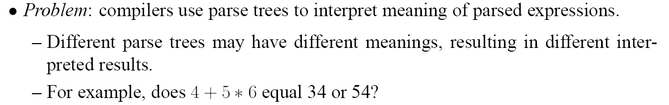
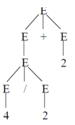
Problems of Ambiguous Grammar
4 / 2 + 2
4
1
This parse tree gives the Right Answer.
4 / 2 + 2 = 4

Slide 45
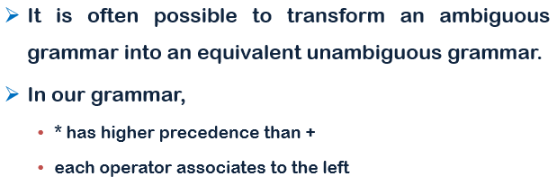
Problems of Ambiguous Grammar
The Ambiguous Grammar does not consider the Precedence and Associativity

Slide 46
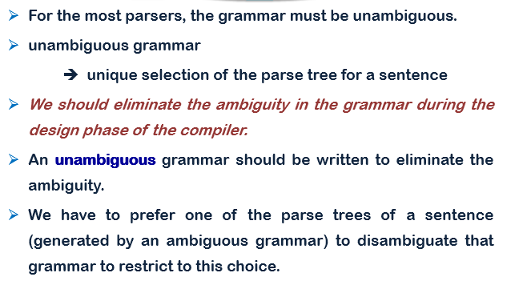
Solution: Removing Ambiguity

Slide 47
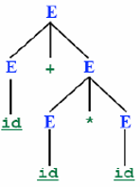
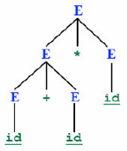
Ambiguous Grammar: How to Solve Associativity Problem?
Operators with
Input: 3 + 2 + 6
Parse Tree -1
Parse Tree -2
Two different parse trees!!
According to the Grammar both are correct.
But Parse Tree-1 gives WRONG answer and Parse Tree-2 gives RIGHT answer.
Ambiguous Grammar
E →E + E
E → E * E
E → num
num(3)
num(6)
num(2)
num(6)
num(3)
num(2)
Removing the associativity
problem from the Grammar:
Operators with same precedence must be resolved by Associativity
Some operators have left associativity (+, -, *, /) and some operators have right associativity (^)
E → E + num
E → E * num
E→ num
Still it is an Ambiguous Grammar!!

Slide 48
Ambiguous Grammar: How to Solve Associativity Problem?(2)
Input: 3 + 2 + 6
Parse Tree
Removing the associativity
problem from the Grammar:
num(6)
E → E + num
E → E * num
E→ num
num(2)
Still it is an Ambiguous Grammar!!
num(3)

Slide 49
Ambiguous Grammar: How to Solve Precedence Problem?
Input: 3 + 2 * 6
Parse Tree -1
Parse Tree -2
Two different parse trees!!
According to the Grammar both are correct.
But Parse Tree-1 gives RIGHT answer and Parse Tree-2 gives WRONG answer.
Ambiguous Grammar
E →E + E
E → E * E
E → num
num(3)
num(6)
num(2)
num(6)
num(3)
num(2)
After Conversion to
Unambiguous Grammar:
Lower precedence operation rules should be declared in the upper level in the Grammar
Higher precedence operation rules should be declared in the lower level in the Grammar
E → E + T | T
T → T * F | F
F → num

Slide 50
Ambiguous Grammar: How to Solve Precedence Problem?(2)
Input: 3 + 2 * 6
Parse Tree
After Conversion to
Unambiguous Grammar:
T
T
T
F
E → E + T | T
T → T * F | F
F → num
F
F
num(6)
num(3)
num(2)

Slide 51
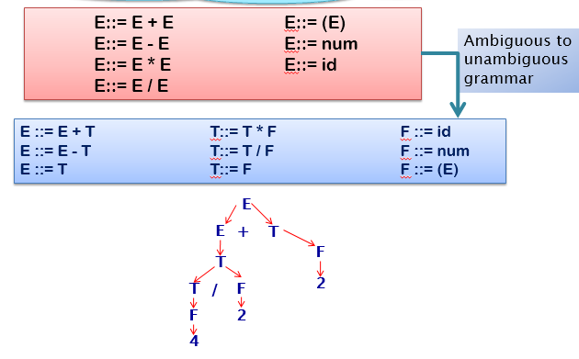
Unambiguous Grammar

Slide 52
Reading Materials
Chapter -4 of your Text book:
Compilers: Principles, Techniques, and Tools

Slide 53
The End

